Slide 1

Folk Dance
By- Aniket Sharma
Class- 3AB

Slide 2

Folk Dance
Folk Dance
By- Aniket Sharma
Class- 3AB

Slide 3
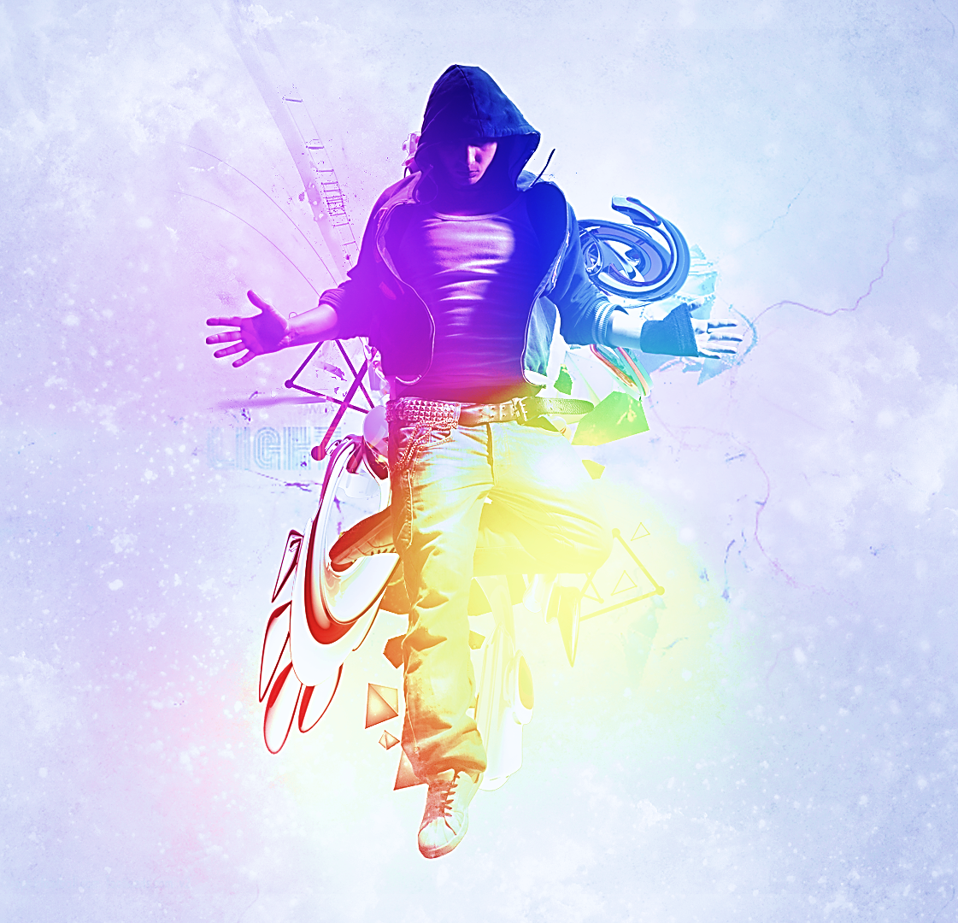
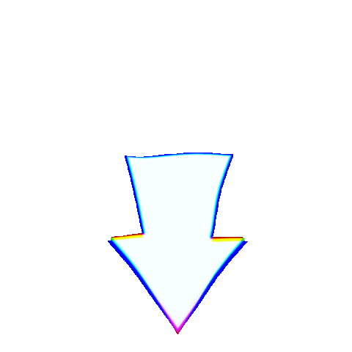
Index
What is folk dance?
Variety of folk dance
Bhangra
Bihu
Kathak
Ghumar
Kathakali
Bharatanatyam
RasLeela
Click these to explore specific topics

Slide 4
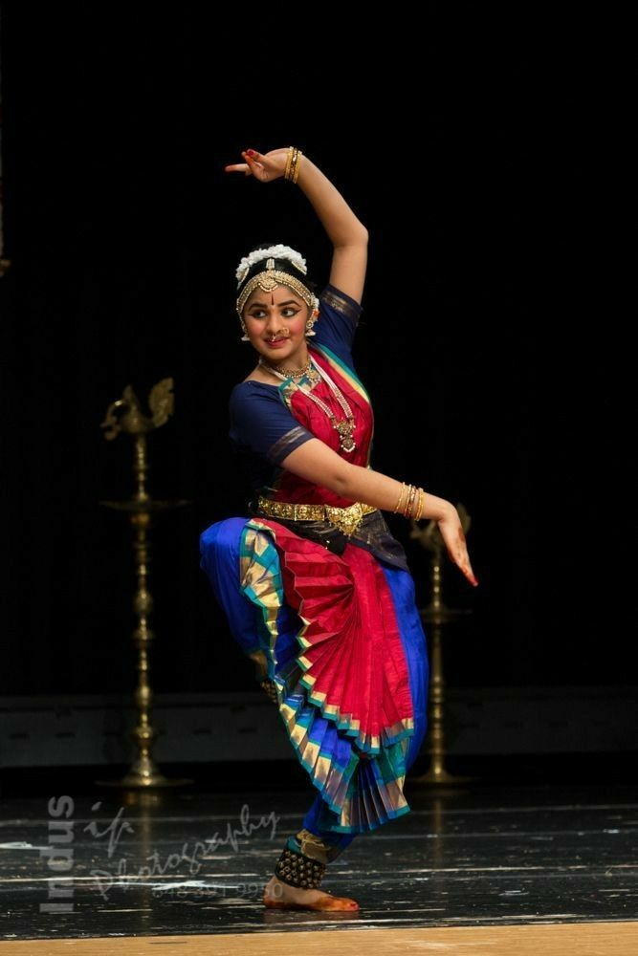
What is folk dance?
A folk dance is a dance developed by people that reflect the life of the people of a certain country or region. Not all ethnic dances are folk dances.
For example, ritual dances or dances of ritual origin are not considered to be folk dances.

Slide 5
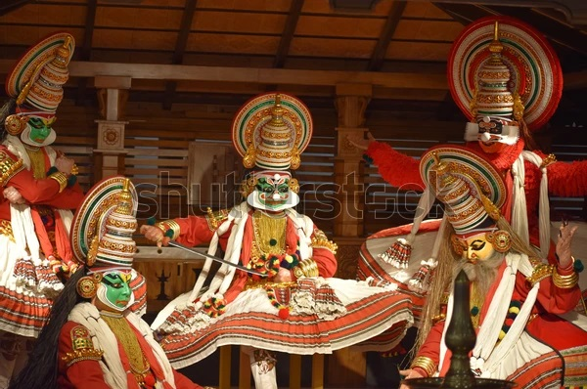
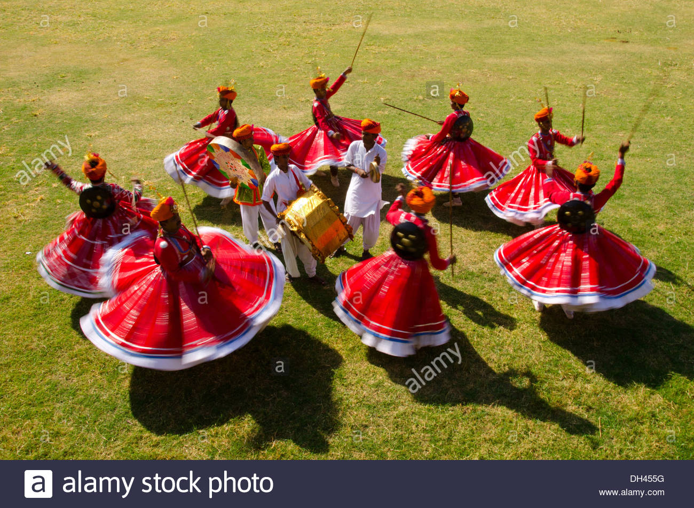
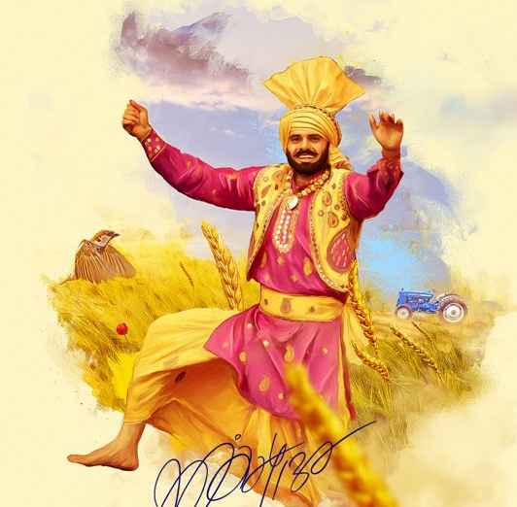
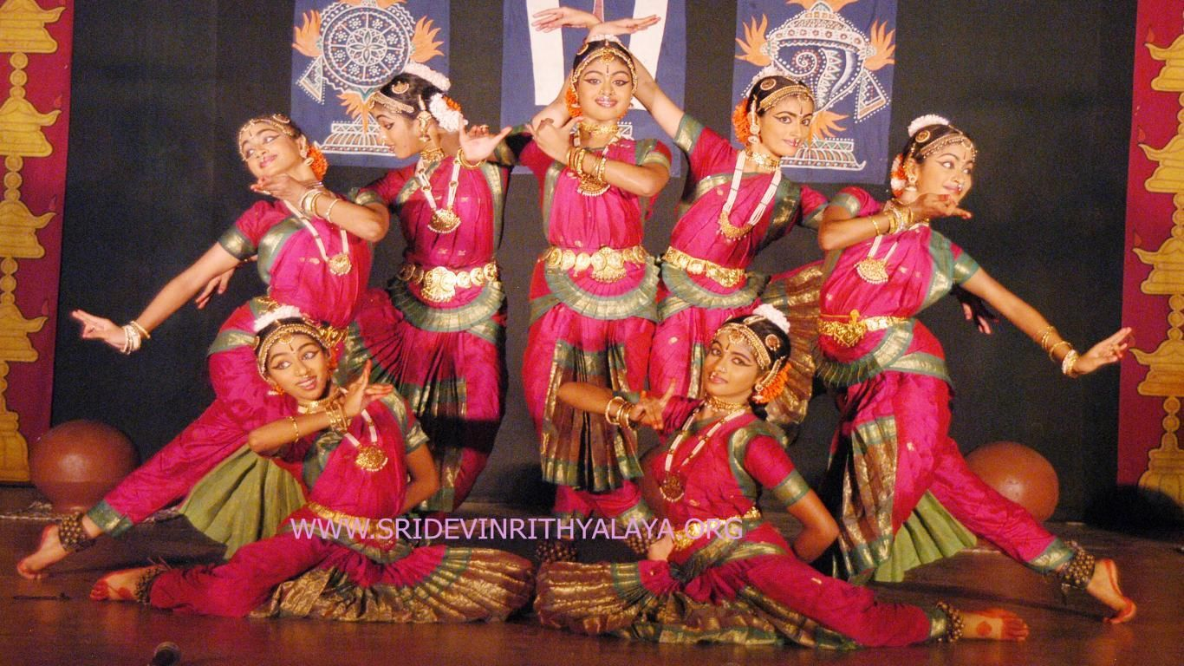
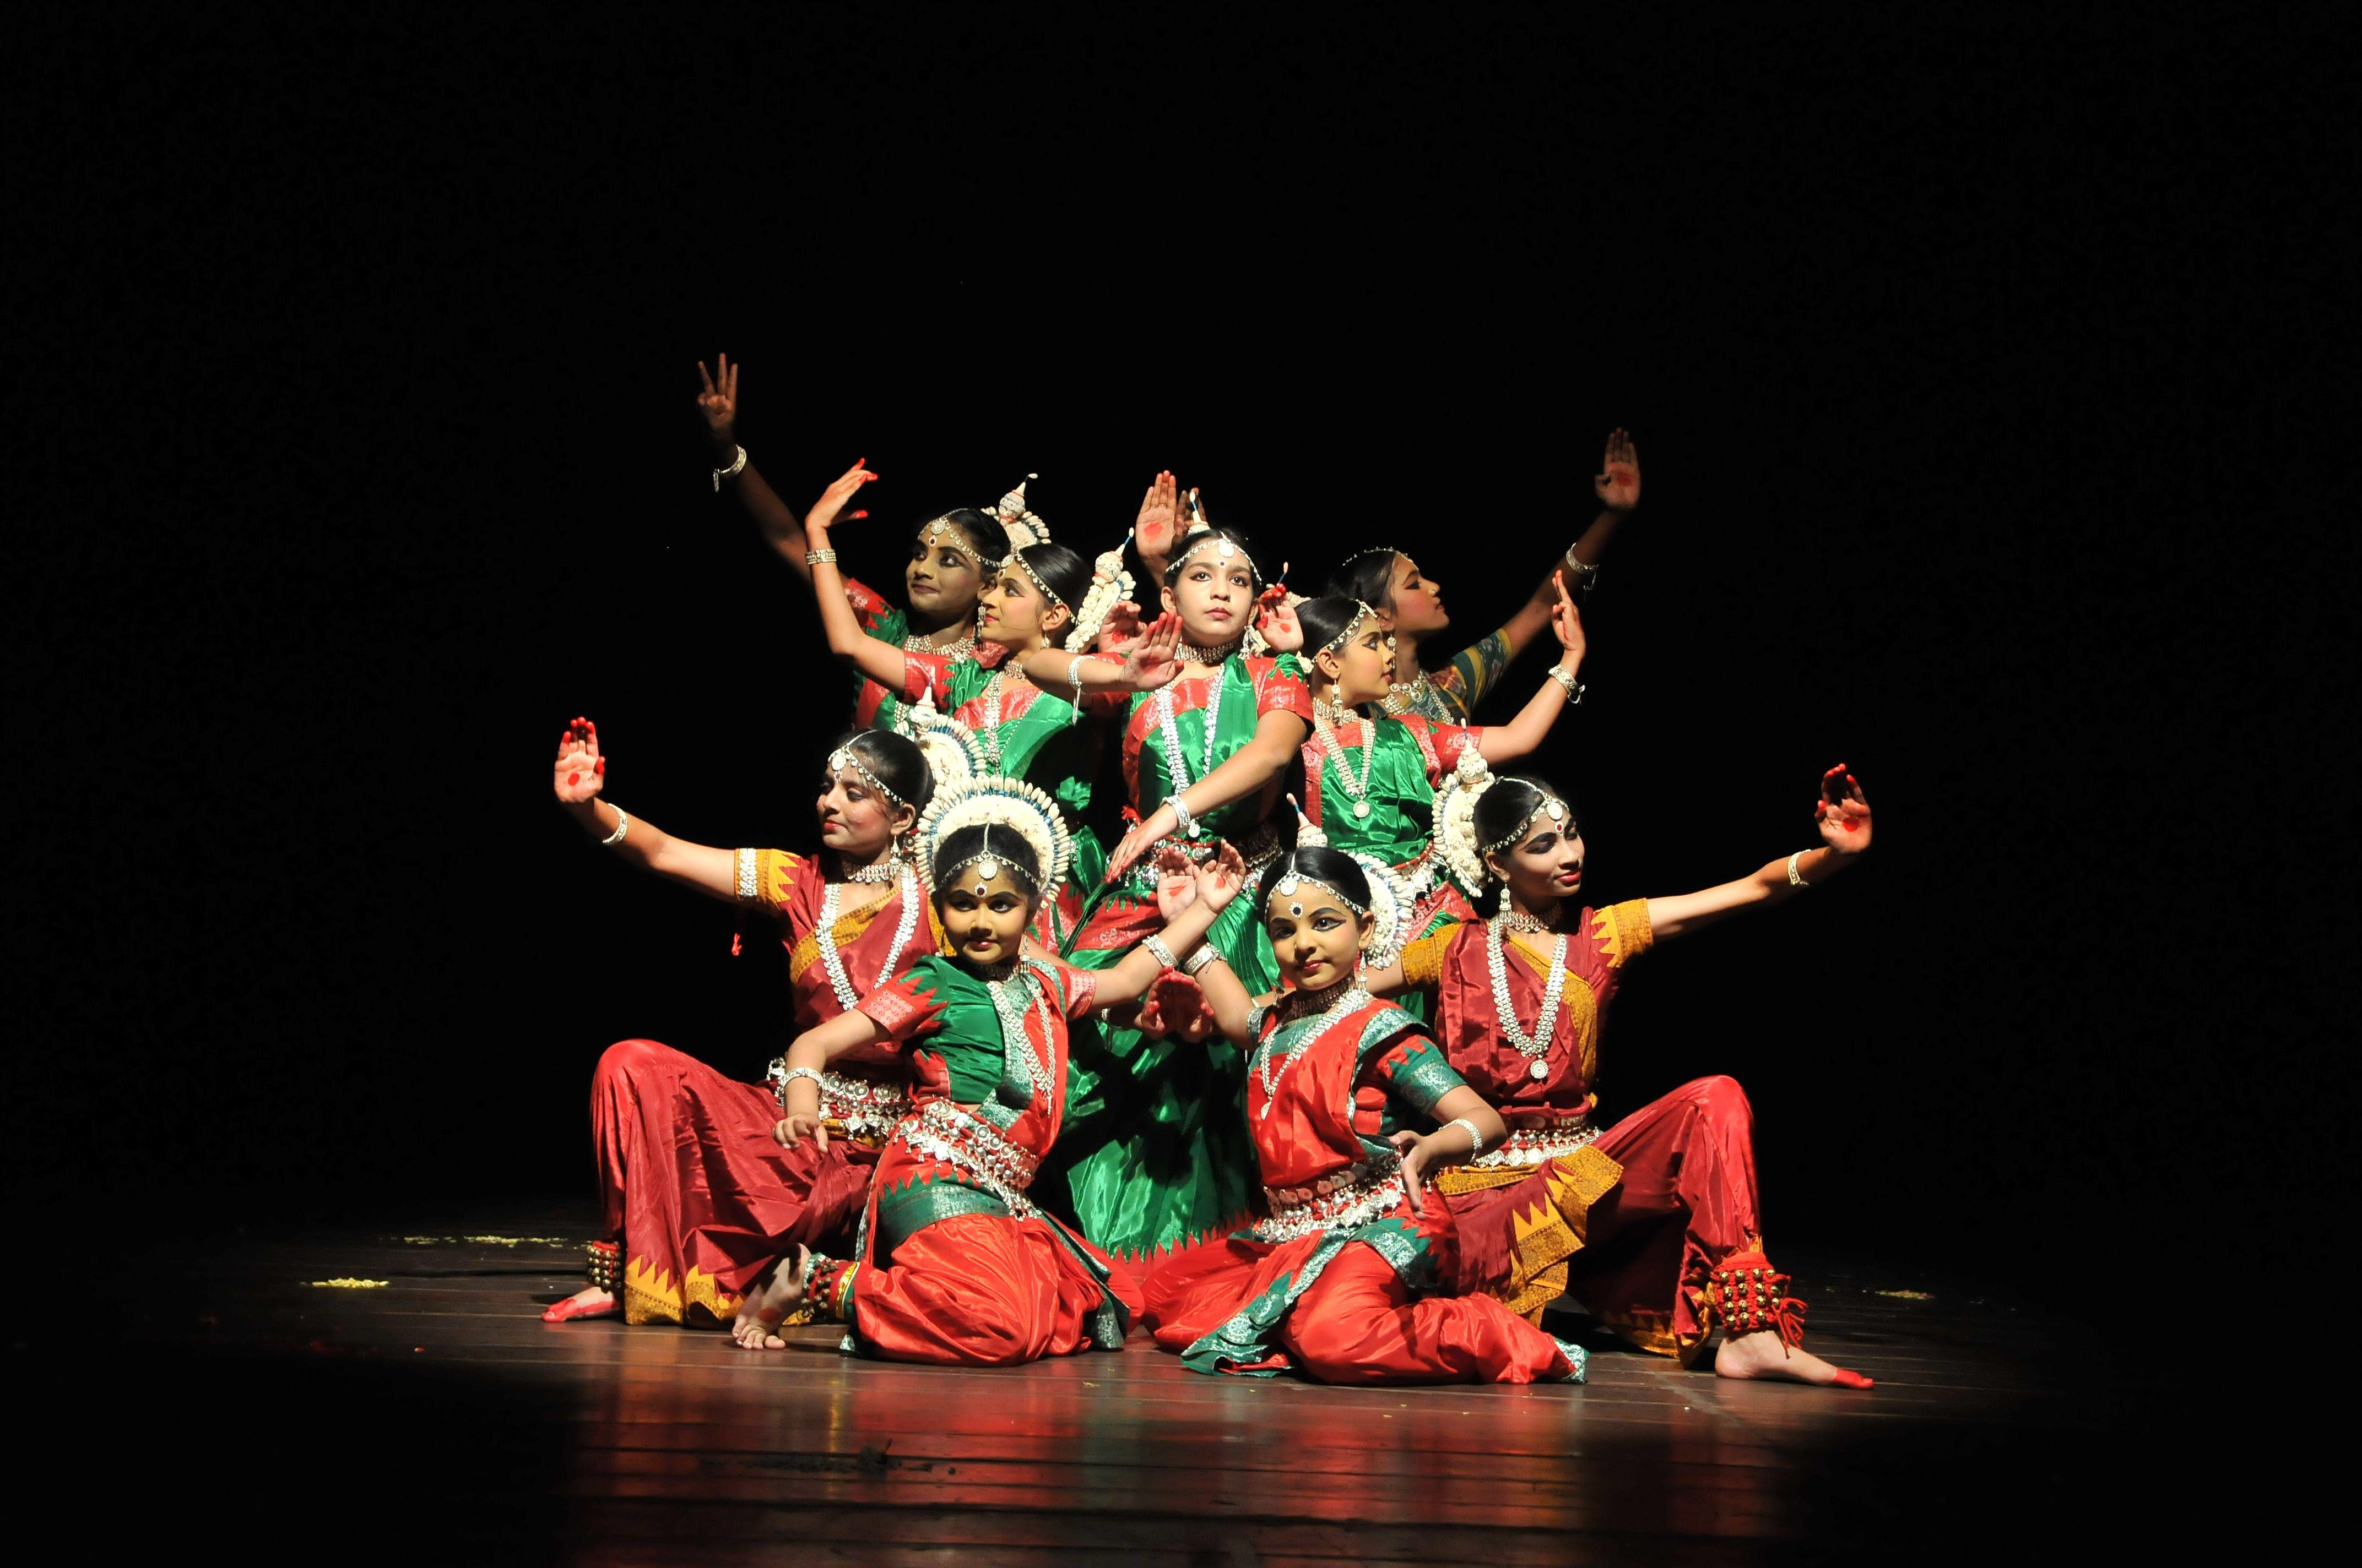
Variety of folk dance
Kathakali
Ghoomar
Bhangra
Kathak
Bharatanatyam

Slide 6
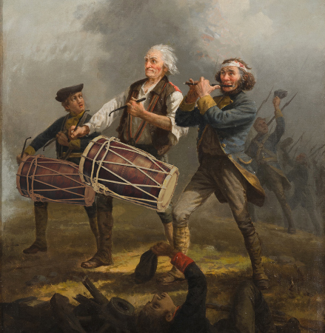
Bhangra – Punjab
Bhangra is a type of traditional folk dance of the Indian subcontinent, originating in Sialkot in the Majhaarea of Punjab.
In a typical performance, several dancers execute vigorous kicks, leaps, and bends of the body—often with upraised, thrusting arm or shoulder movements—to the accompaniment of short songs called boliyan and, most significantly, to the beat of a dhol (double-headed drum).

Slide 7
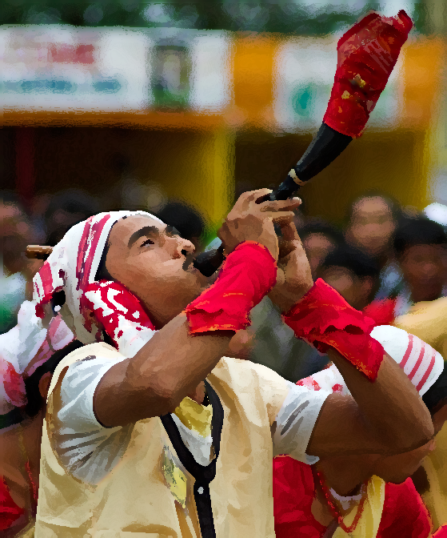
Bihu-Assam
The Bihu dance is an indigenous folk dance from the Indian state of Assam related to the Bihu festival and an important part of Assamese culture.
Performed in a group, the Bihu dancers are usually young men and women, and the dancing style is characterized by brisk steps, and rapid hand movements.
The traditional costume of dancers is colorful and centred round the red colour theme, signifying joy and vigour.

Slide 8
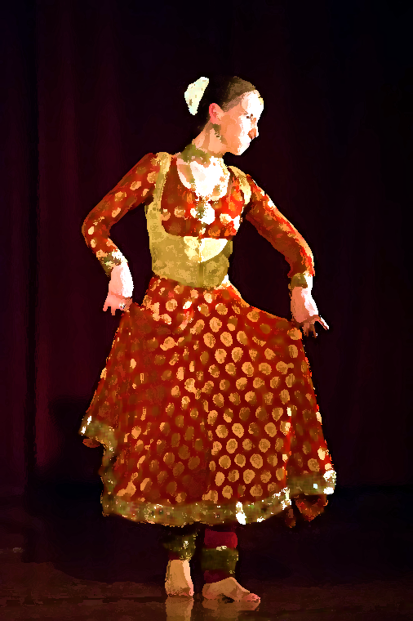
Kathak
Kathak is one of the eight major form of Indian classical dance.
The origin of Kathak is traditionally attributed to the traveling bards in the of ancient northern India known as Kathakars or storytellers.
The term Kathak is derived from the Vedic Sanskrit word Katha which means "story", and Kathakar which means "the one who tells a story", or "to do with stories".
Kathak dancers tell various stories through their hand movements and extensive footwork, their body movements and flexibility but most importantly through their facial expressions.

Slide 9
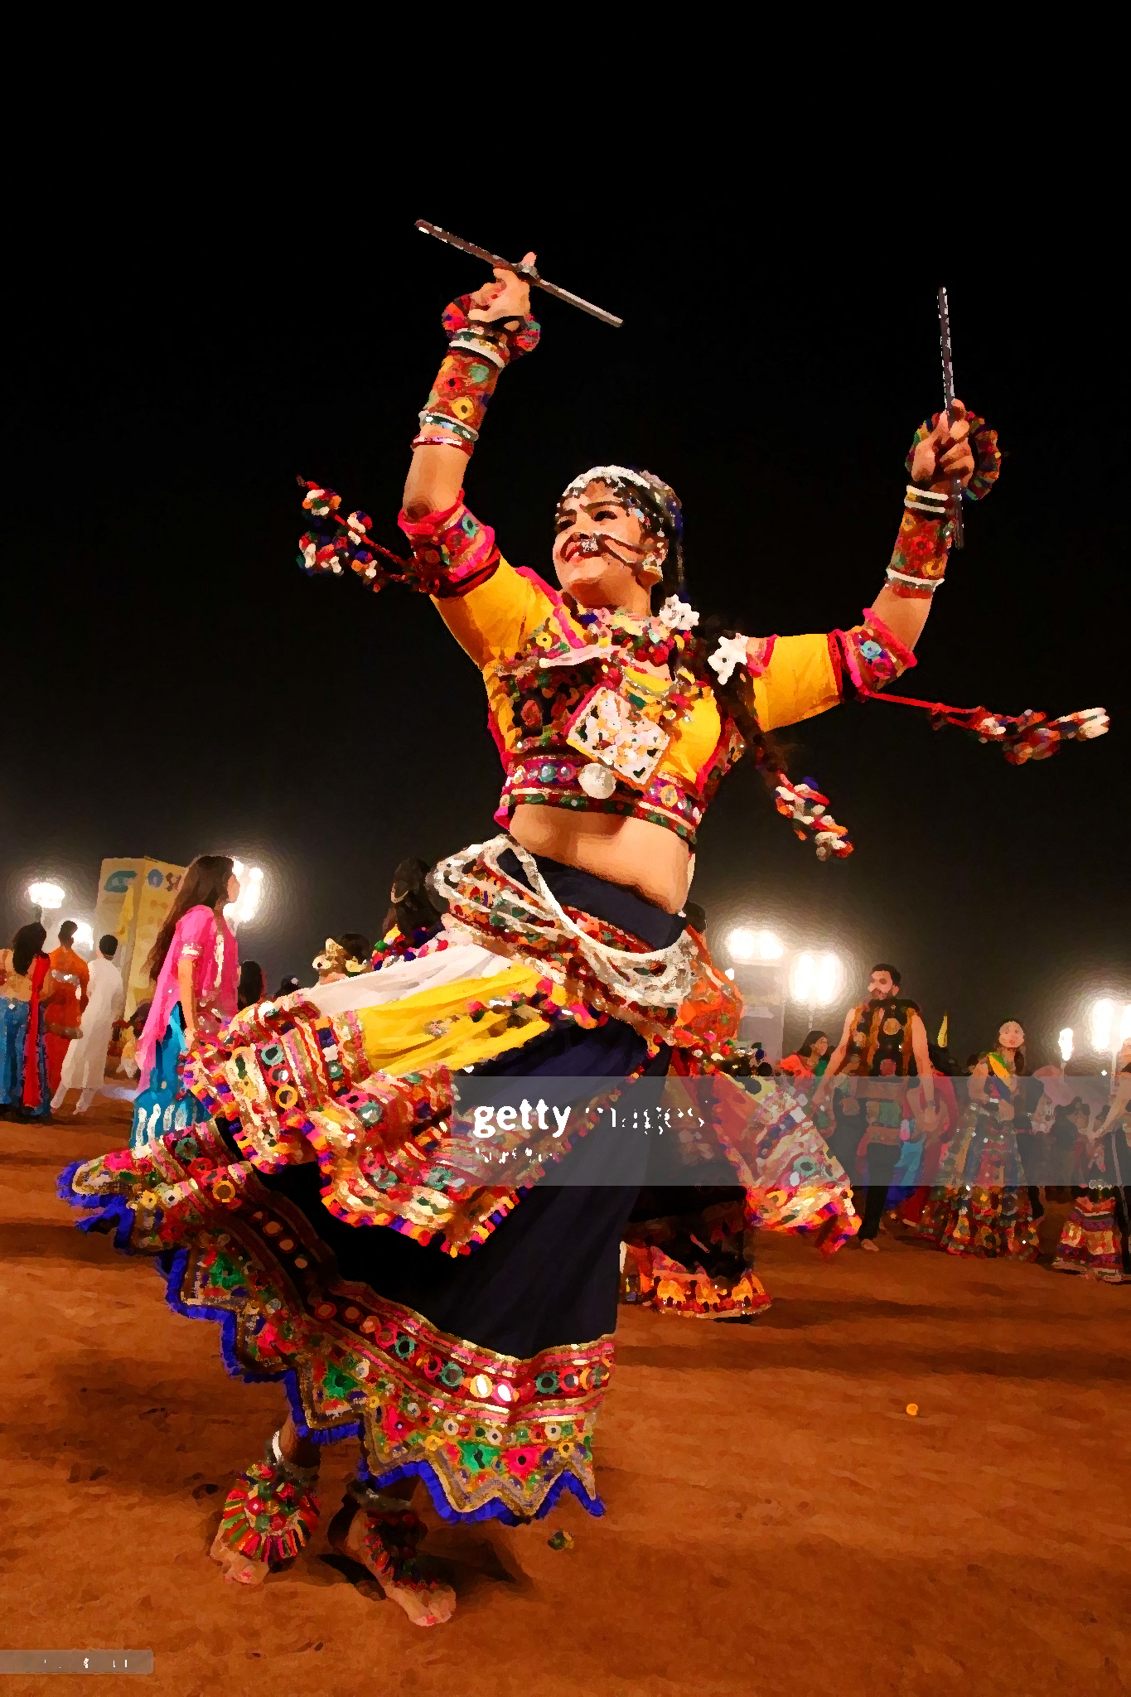
Ghumar-Rajasthan
Ghoomar or Ghumar is a traditional folk dance of Rajasthan.
It was Bhil tribe who performed it to worship Goddess Sarasvati which was later embraced by other Rajasthani communities.
The dance is chiefly performed by veiled women who wear flowing dresses called Ghaghara.
It was ranked 4th in the list of "Top 10 local dances around the world" in 2013.
The dance typically involves performers pirouetting while moving in and out of a wide circle. The word ghoomna describes the twirling movement of the dancers and is the basis of the word ghoomar.

Slide 10
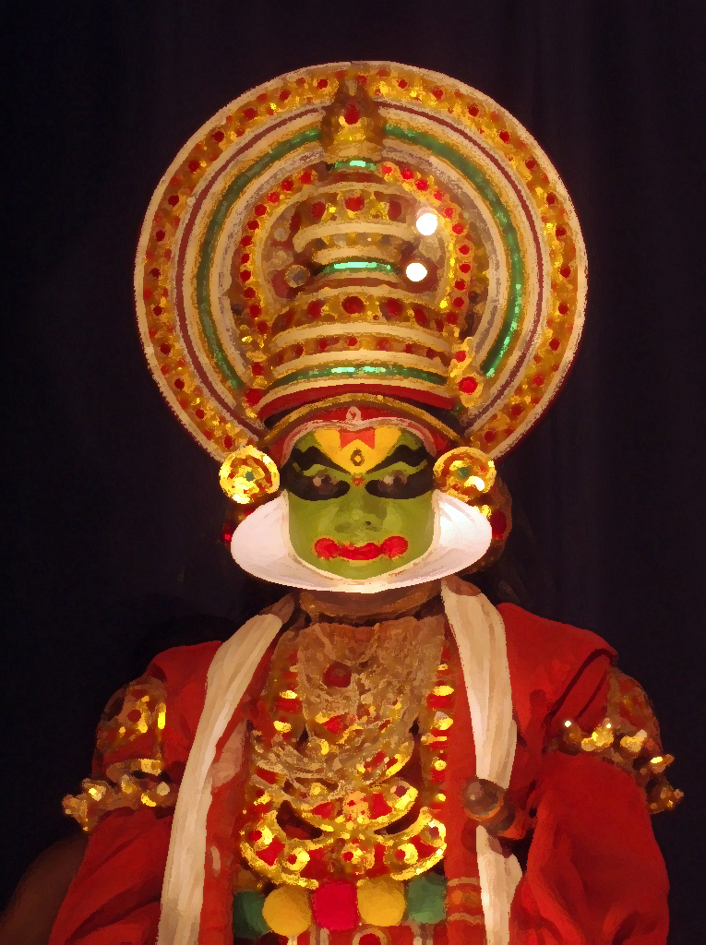
Kathakali-Kerala
Kathakali is a major form of classical Indian dance.
It is a "story play" genre of art, but one distinguished by the elaborately colorful make-up, costumes and face masks that the traditionally male actor-dancers wear.
Kathakali is a Hindu performance art in the Malayalam-speaking southwestern region of Kerala.
The fully developed style of Kathakali originated around the 17th century, but its roots are in the temple and folk arts southwestern Indian peninsula), which are traceable to at least the 1st millennium CE

Slide 11
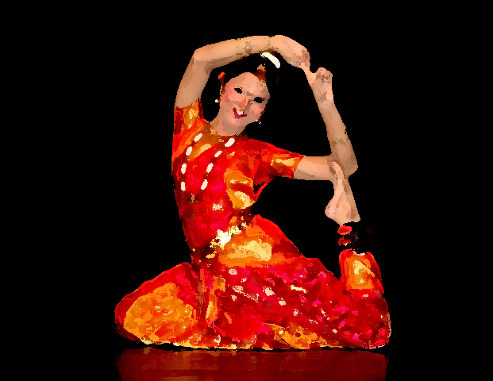
Bharatnatyam-Tamil Nadu
Bharatanatyam(oldest) also called as Sadhir Attam, is a major form of Indian classical dance that originated in Tamil Nadu.
It has flourished in the temples and courts of southern India since ancient times.
It is one of the widely recognized eight forms of Indian classical and it expresses South Indian religious themes and spiritual ideas, particularly of Shavism, Vaishnavism and Shaktism.
Description of Bharatanatyam by 2nd century CE is noted in the ancient Tamil epic Silappatikaram, while temple sculptures of 6th to 9th century CE suggest it was a well refined performance art by the mid-1st millennium CE.

Slide 12
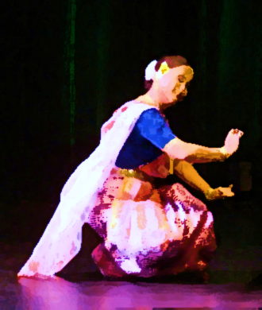
Ras Lila-Manipur
The Ras lila or Ras dance or Krishna Tandava, is part of the traditional story of Krishna described in Hindu scriptures such as the Bhagavata Purana and literature such as the Gita Govinda, where he dances with Radha and her sakhis (Gopis).
The Indian classical dance of Kathak evolved from the ‘Raslila’ of Braj and Manipuri Classical Dance' (Vrindavana) also known as Natwari Nritya, which was revived in 1960s by the Kathak dancer, Uma Sharma.

Slide 13

Created by-
Aniket Sharma
3 AB
Special Thanks to-
My brother
For helping me with this project
Created by-
Aniket Sharma
3 AB
Special Thanks to-
My brother
For helping me with this project

